Slide 1






MEJANA
Notes:
#0 Pitch Slide
XXX
Imagine if you could throw some of your worries and fears overboard – without any consequences and without having to do anything significant.
XXX
What if I told you that all you have to do is to install an app and carry your smartphone with you. XXX
In return, you will have someone at your side.
Someone who accompanies you everywhere.
Someone who takes care after you. XXX
Someone who has impressive intelligence and advisory skills regarding all aspects of safety.
XXX
Someone who can make the difference in dangerous and life-threatening situations.
What am I talking about? I'm talking about MEJANA.XXX
MEJANA is an artificial intelligence in the form of an innovatie application.
What we intend to do within the next few minutes is to give you a fascinating glimpse into the mind of MEJANA.

Slide 2

Empowering individuals to feel safe and secure every day #StaySafe
M E J A N A
Notes:
#1 COVER SLIDE

Slide 3

PROBLEM
In Germany, 37% of women and 13% of men feel unsafe when walking alone at night.
Notes:
Zusammenfassen auf 1 Slide

Slide 4
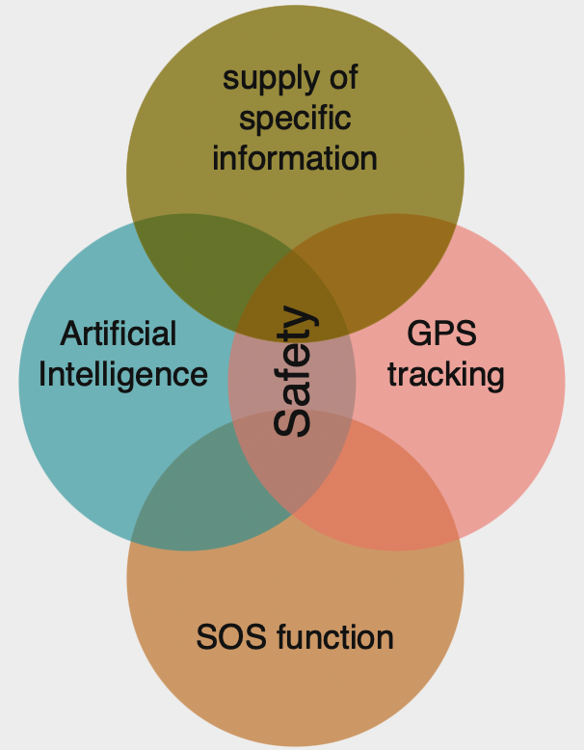
SOLUTION
Notes:
#3 Solution Slide
Our answer to the problem is: more security, less fears, less worries, more quality of life
Our definition of security is based on 4 aspects.
GPS tracking allows the location to be transmitted in case of an emergency.
In an emergency, the SOS function is automatically triggered and an emergency call is made.
Security-relevant information is shared and sent to users in the form of warnings and messages.
And all these functions use MEJANA's impressive artificial intelligence

Slide 5
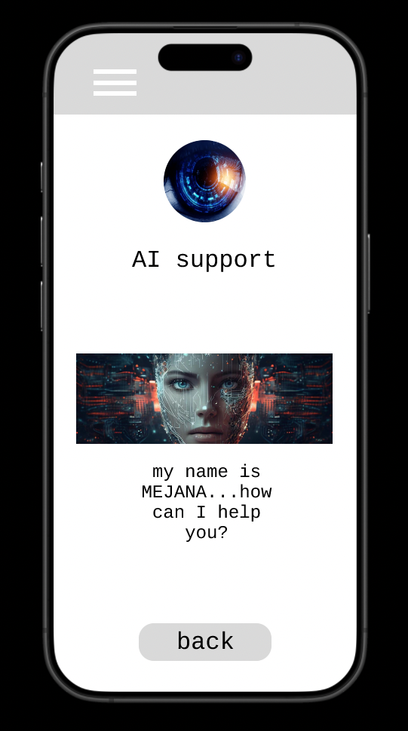
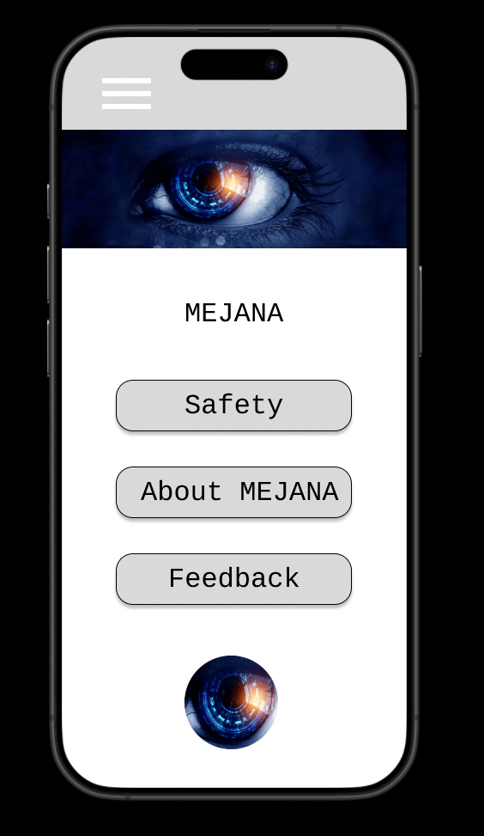
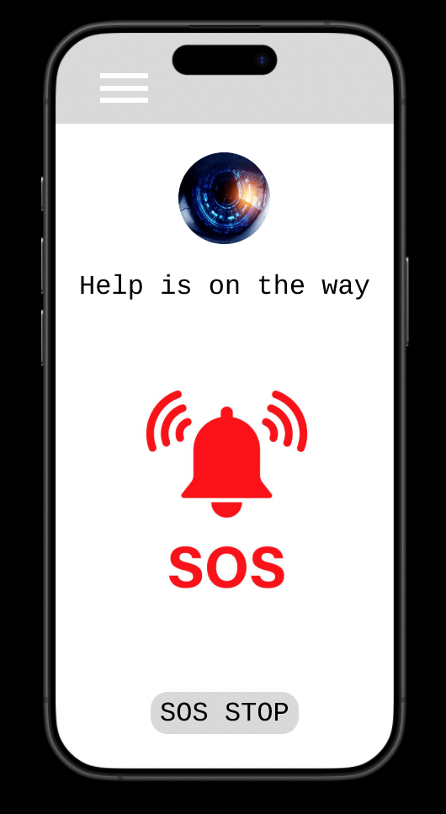
Notes:
#4 Underlying Magic Slide
The app can be operated entirely by voice command, but can also be operated manually.
In emergencies, MEJANA actively speaks to you and gives you instructions. You can of course ask her questions - she will always has helpful advice.
MEJANA independently recognizes whether an emergency has occurred and can differentiate between different types of emergencies and makes an emergency call including your location and a brief description of the problem.
Feedback is critical for our startup because it is free, it helps us to involve our stakeholders so we can develop step by step.

Slide 6
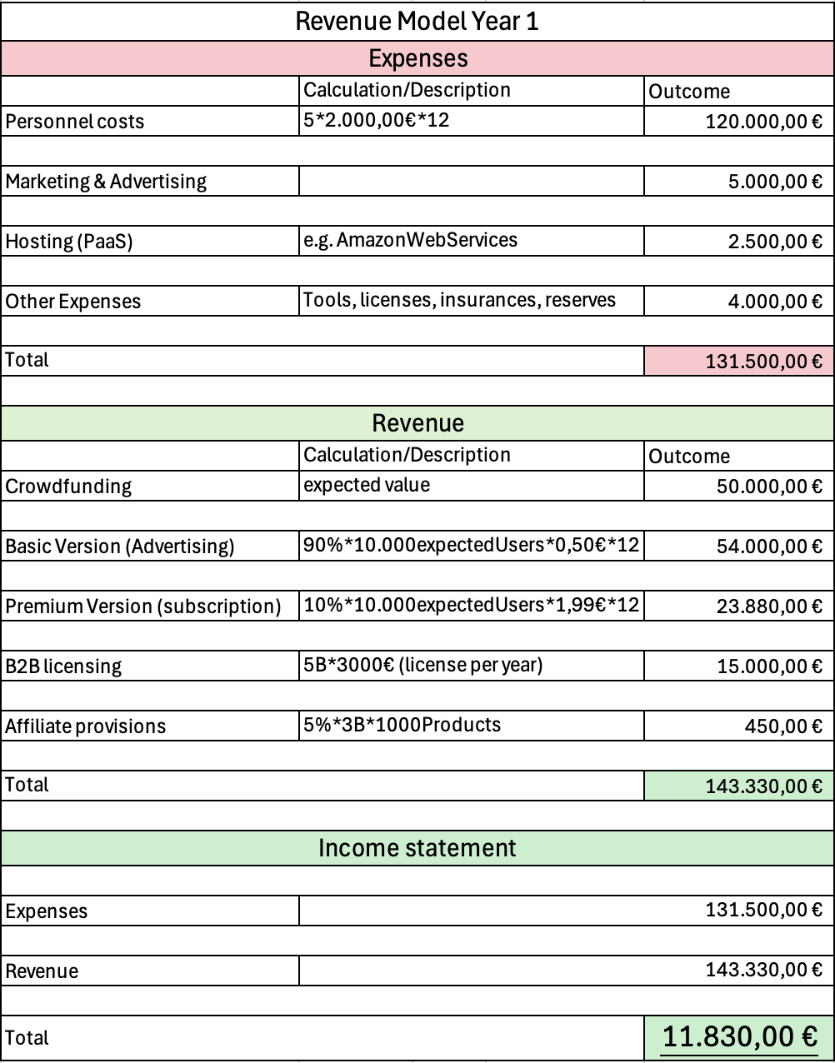
REVENUE MODEL
FREEMIUM-MODEL
Basic Version:
Fundamental functions
Revenue through:
Advertising
Premium Version:
Extended functions
Revenue through subscription
Monthly 1,99€
Additional Income:
Crowdfunding
B2B licenses
Affiliate Marketing
Notes:
So, how do we secure income?
We have decided to choose a Freemium-Model to generate revenue.
Therefore we want a basic version and a premium version for our Mejana Application.
The basic version provides fundamental functions, like:
Real-time GPS Tracking and a SOS-Function
The basic version is available in the Google Play or the app store for free!
We want to earn revenue through advertising.
Our Premium model provides a bunch of additional features, like:
An AI voice assistant or health care tracking.
Our income here is generated by a monthly subscription of 1,99€ per month.
In the revenue model on the right you can see the calculations we made for the first year.
in total, we have expenses of 131.500 euro and income of 143.333 euros. this means we generate a profit of 11.830 euros.
Now Mehmed will continue with a competitive analysis.

Slide 7









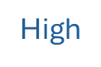
COMPETITIVE ANALYSIS
High
middle
high
Price
middle
MEJANA
low
Low
Performance
Notes:
Now we come to our competitors, which we have represented using the Otto Matrix. which maps the competitive landscape of similar applications based on price and performance.
On the X-axis, we have performance, ranging from low to high, and on the Y-axis, we have price, also ranging from low to high. This framework helps us to show where competitors are positioned in terms of value and functionality.
For example, in the high performance and high price square, we see applications like Life360, AngelSense which offer premium features but at a higher cost. Costs are over 20$. In contrast, apps like bSafe are positioned in the high price and middle performance area, targeting a more cost-sensitive audience.
In the middle price range and high performance, we see competitors like Noonlight, Mejana, and SOSmart, which aim to balance affordability with strong performance. These players dominate the middle ground and are significant competitors in the market.
The matrix shows that we offer high performance and a lower price which sets us apart from the competition. According to our plan, we would offer better performance than our competitors

Slide 8
MARKET SIZE
users of smartphones
Assumption: 4,48 billion
Total Addressable Market
People who search for emergency apps Assumption: 70 mio.
Serviceable Available Market
people who want to increase their personal safety in everyday life Assumption: 23 mio.
Serviceable Obtainable Market
Notes:
Now I want to show you our market size. At the outermost circle, we have the Total Addressable Market. This includes all smartphone users with internet connection worldwide, representing the largest possible group of users for our application. This step ensures that the application is accessible to those with the technical infrastructure needed to use it effectively.
Next, the Serviceable Addressable Market further narrows the scope by focusing on people who are looking for safety apps. According to our assumption that will be 15 million people.
Finally, at the core, we have the Serviceable Obtainable Market. This is the most realistic and actionable segment, consisting of customers who want to increase their personal safety but are also willing and financially able to pay for it. This group forms the foundation of our revenue potential.
By moving through these levels, we can strategically identify and target the most relevant and viable markets for our product

Slide 9
GO TO MARKET STRATEGY
Target customers!
Primary target group: Individuals who move around in unsafe environments (e.g. women travelling alone, night shift workers, senior citizens)
Secondary target group: Families who want to protect their children or elderly relatives
Companies: Companies that want to provide their employees with security tools
Notes:
Zusammenfassen auf 1 Slide

Slide 10
GO TO MARKET STRATEGY
Distribution-channel: 1. Digital marketing | Distribution-channel: 2. Stores
Distribution-channel: 3. Partnerships | Distribution-channel: 4. Offline channels
= PRE-/POST Launch!
Notes:
Digital marketing:
•Search engine optimisation (SEO): optimisation for keywords such as ‘best security app’, ‘personal protection’, etc.
•Social media marketing: targeted adverts on platforms such as Instagram, Facebook and TikTok that showcase the app's features
•Influencer marketing: collaboration with personalities from the fields of travel, technology and personal well-being
•Content marketing: blog articles, videos and podcasts on security and data protection
Stores:
•App Store Optimisation (ASO): optimised titles, descriptions and screenshots in app stores
•Launch promotions, e.g. free access for the first three months
Partnerships:
•Co-operations with security companies, travel agencies or mobile phone providers
•Offering the app to schools, universities or employers as part of their safety plan
Offline channels:
•PR campaigns with security organisations
•Advertising on public transport or in highly frequented locations
Soft-Launch:
•Launch in a limited geographical area to collect feedback from users and optimise the app
•Pilot projects with partners (e.g. companies or universities)
Full-Launch:
•broad rollout with comprehensive marketing campaign
•utilisation of user-generated content (e.g. testimonials and reviews)

Slide 11
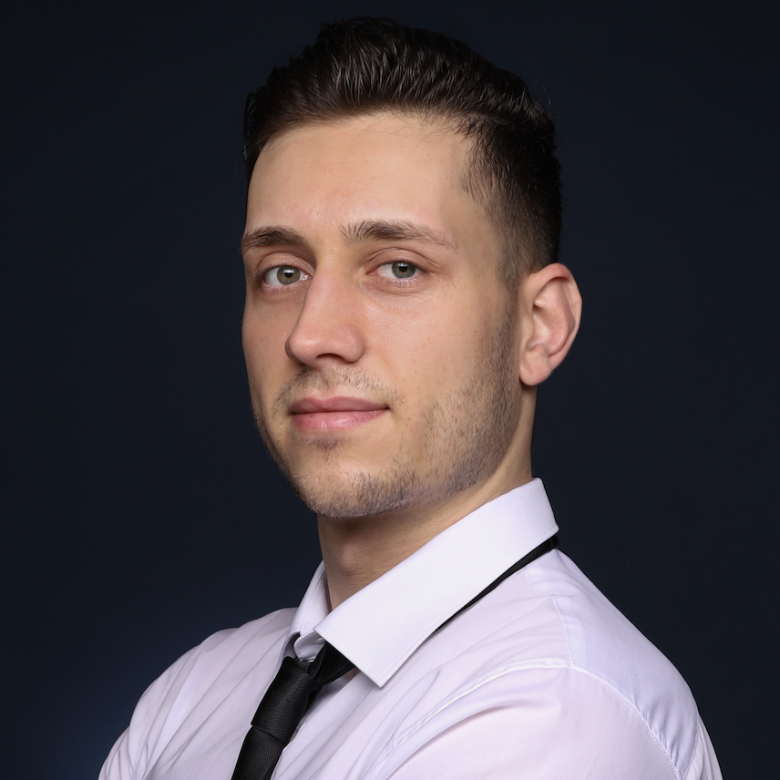
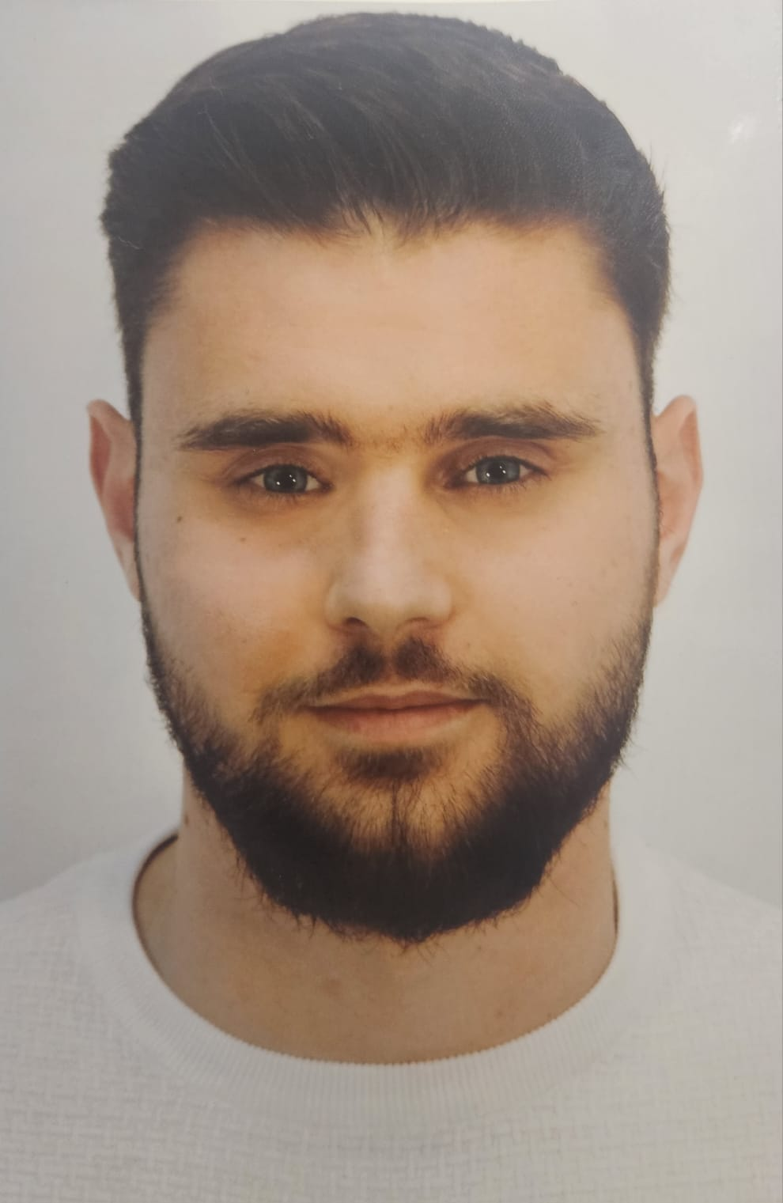
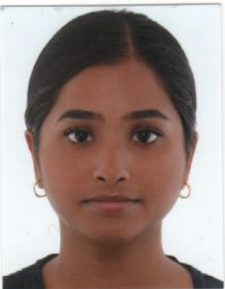
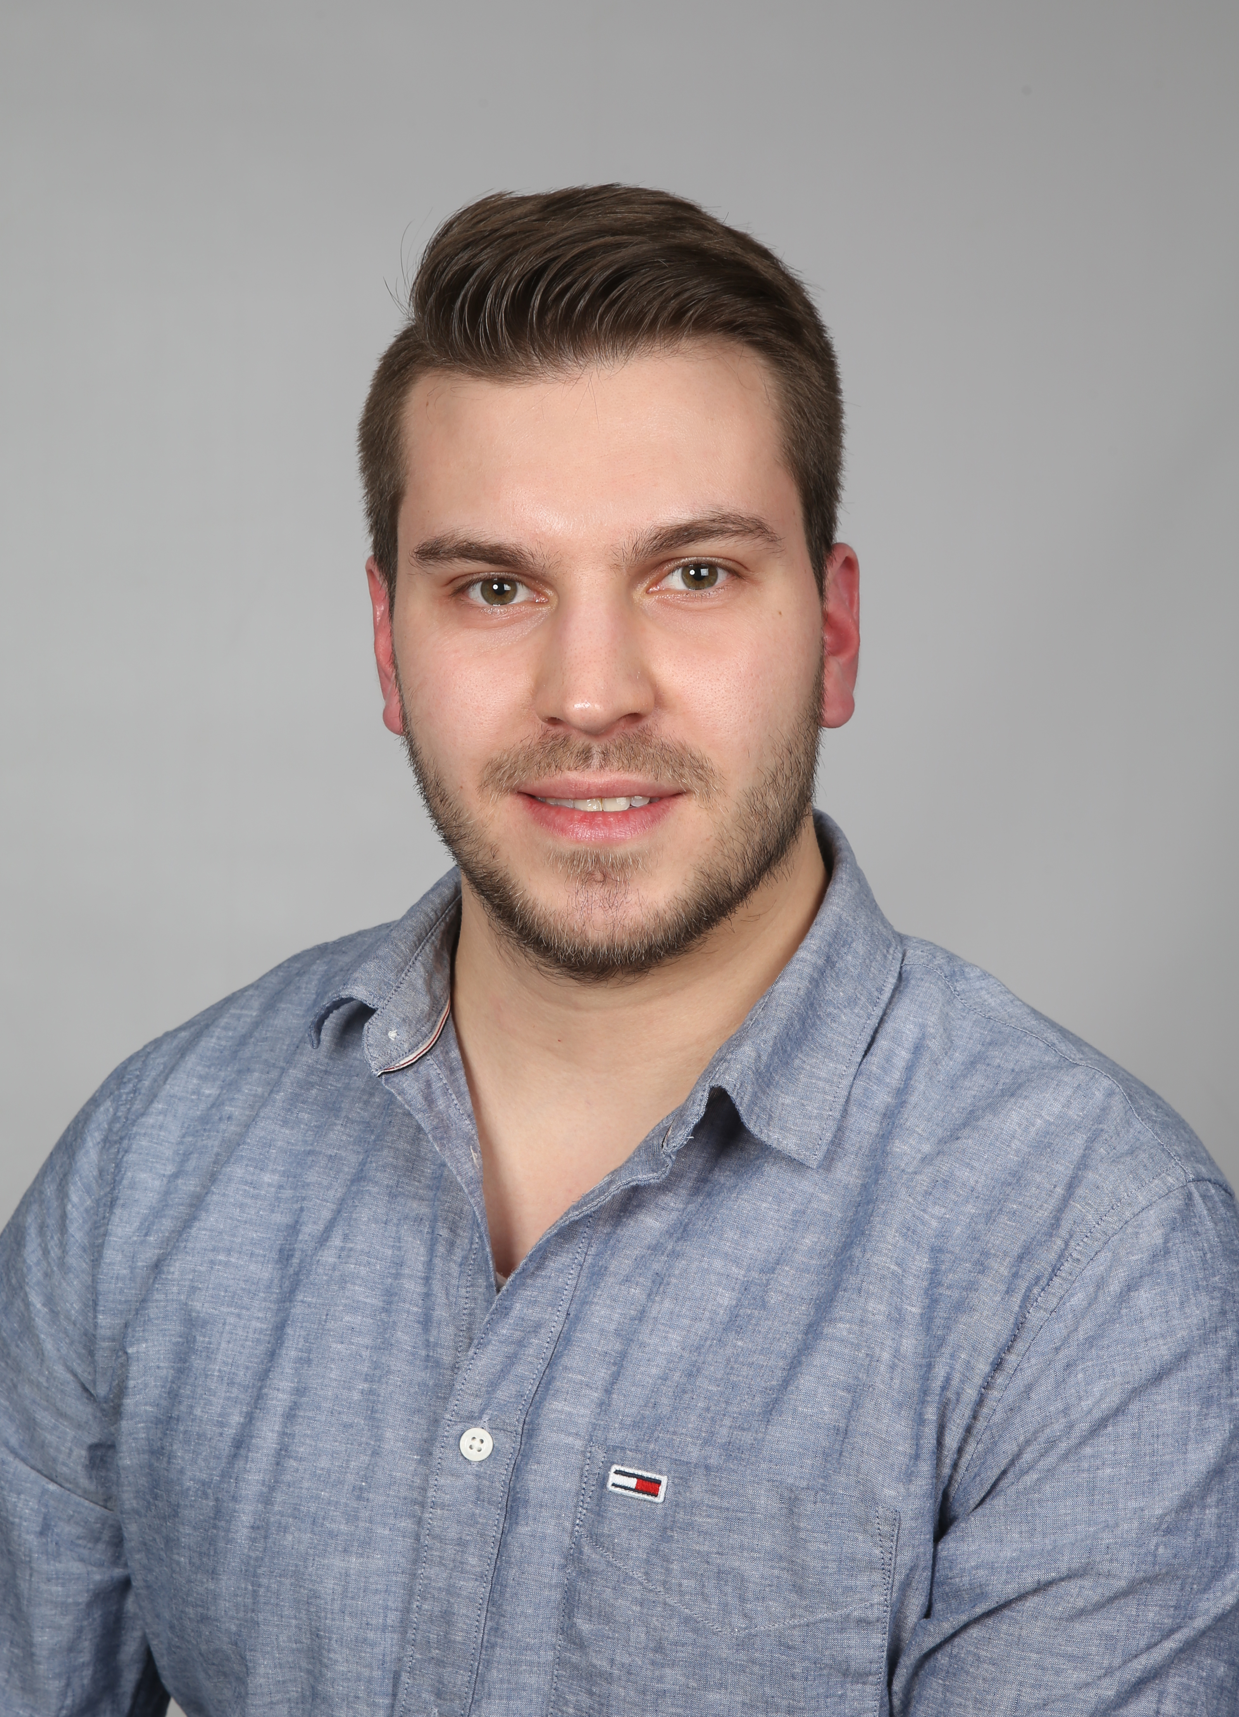
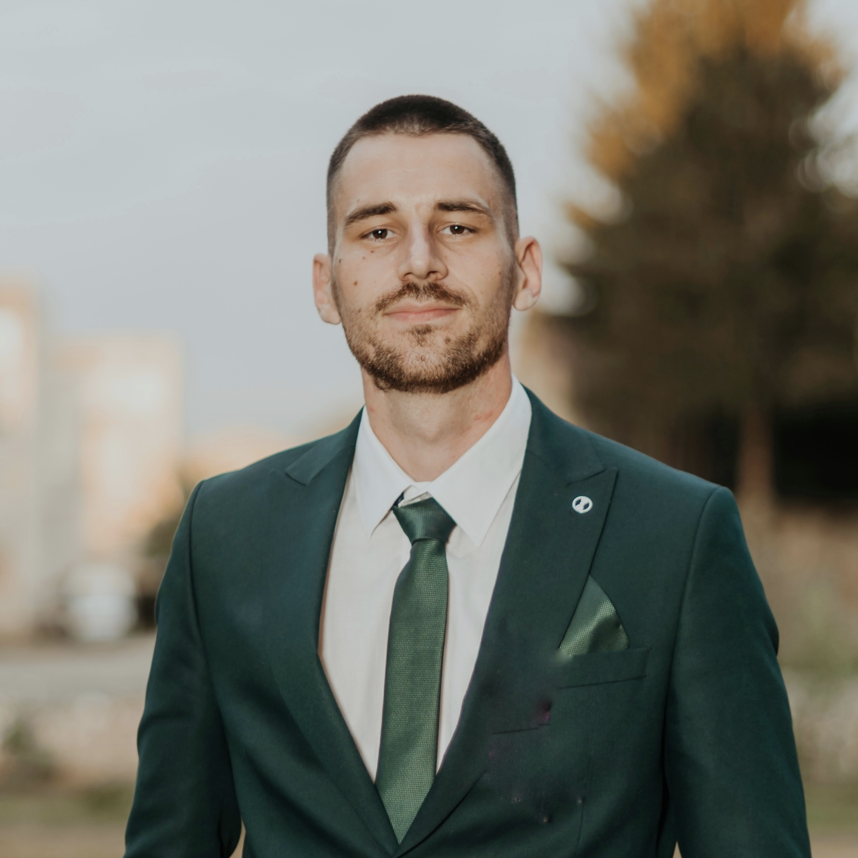
TEAM
Marco – Technician
Jan - Manager
Nadja – Analyst
Chris – Technician
Mehmed – Creative
Notes:
Zusammenfassen auf 1 Slide

Slide 12
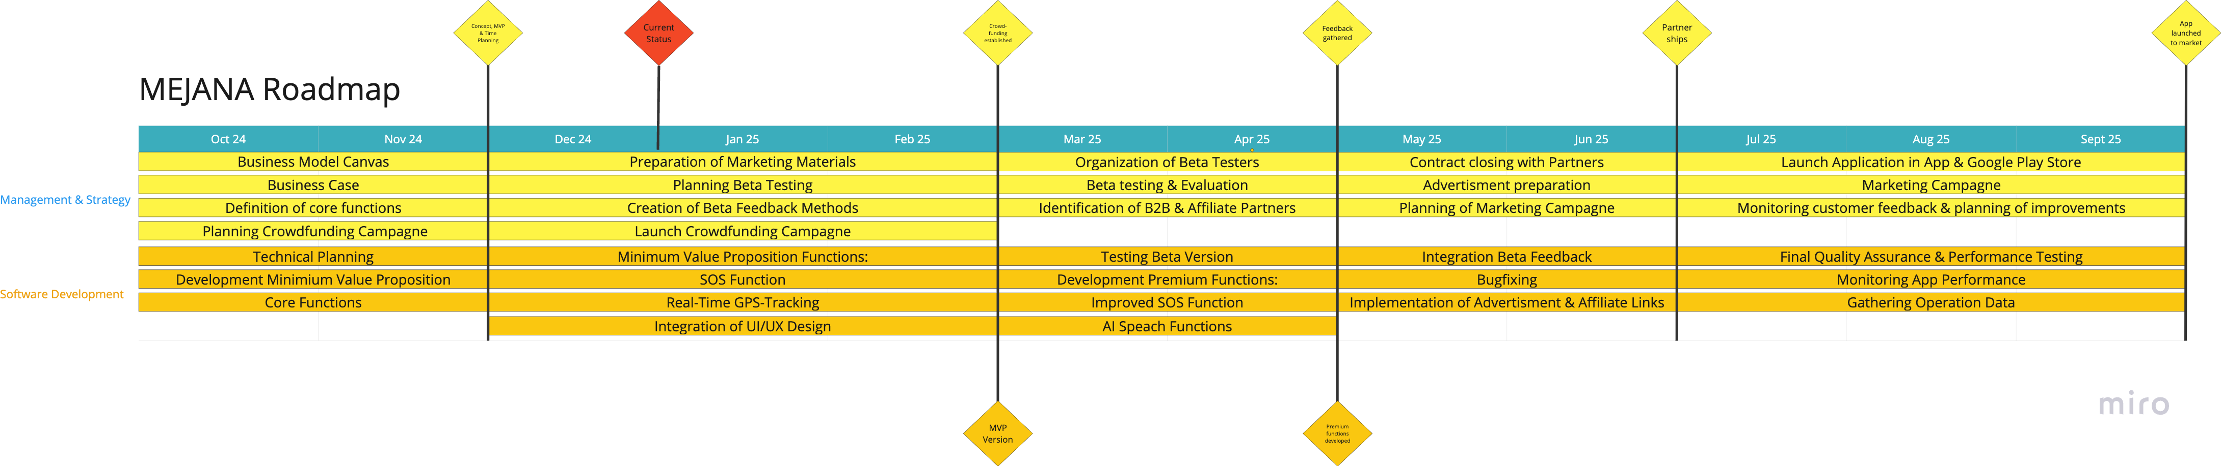
CURRENT STATUS & ROADMAP
Notes:
Here you can see our roadmap.
It is divided into 2 domains, Management&Strategy and Software Development.
We got together in october and are now planning for the coming year.
After just 2 months, we have already reached our first milestone, namely creating a concept with minimum value proposition and the planning in terms of time.
We are currently on the verge of the next milestone. Until then, we want to launch a crowdfunding campaign and develop a MVP version.
Just 2 months later, we would like to have gathered and evaluated initial feedback on our beta version and have premium functions developed.
By the end of June 2025, we want to have concluded the first contracts with B2B & affiliate partners and have them implemented into the app.
Our final milestone will be at the end of September 2025, when our product is set to enter the market.

Slide 13
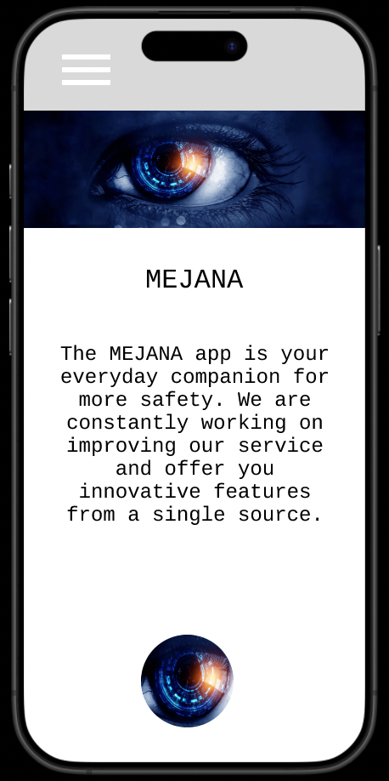

Be ready to download MEJANA and take control of your personal safety!
#StaySafewith
M E J A N A
www.mejana.com
Notes:
#11 Closing with call to action Slide

Slide 14
SOURCE DIRECTORY
Slide 3:
https://www.veko-online.de/archiv-ausgabe-02-2021/sicherheit-umfragen-zufolge-fuehlen-sich-37-der-deutschen-frauen-nachts-nicht-sicher-wenn-sie-allein-unterwegs-sind.html
Slide 8: Smartphones - Nutzer weltweit 2016-2028 | Statista
Slide 9 and 10:
Notes:
#11 Closing with call to action Slide

